Slide 1
Marketing on LinkedIn with Dynamics 365 Marketing
Jesper Osgaard, Microsoft

Slide 2
Dynamics 365 Marketing - One Stop document
FY20 –http://aka.ms/ocp/d365marketing

Slide 3






Agenda
Overview
Lead Gen Integration
Matched Audiences
Customer Journey
Social Posts
Recap

Slide 4
Agenda
Overview
Lead Gen Integration
Matched Audiences
Customer Journey
Social Posts
Recap

Slide 5



Slide 7
Dynamics 365 Marketing offers several features for running and integrating marketing campaigns on LinkedIn
Leads
Audiences
Customer Journey
Social

Slide 8
Integration points
Import leads generated by LinkedIn Lead Gen Forms into Dynamics 365 Marketing
Create LinkedIn Matched Audiences based on Dynamics 365 Marketing segments
Design customer journey triggers that react to Lead Gen Form submissions
Schedule and publish social posts to LinkedIn from Dynamics 365 Marketing

Slide 9
Agenda
Overview
Lead Gen Integration
Matched Audiences
Customer Journey
Social Posts
Recap

Slide 10
Agenda
Overview
Lead Gen Integration
Matched Audiences
Customer Journey
Social Posts
Recap

Slide 11
LinkedIn Lead Gen integration
Bring leads generated in LinkedIn into Dynamics 365

Slide 12
LinkedIn Lead Gen integration
Dynamics 365 Marketing includes a connector for LinkedIn Lead Gen
Use this feature to
see how people are are interacting with your marketing initiatives on LinkedIn
bring leads and lead information generated by using the LinkedIn Lead Gen tools into Dynamics 365

Slide 13
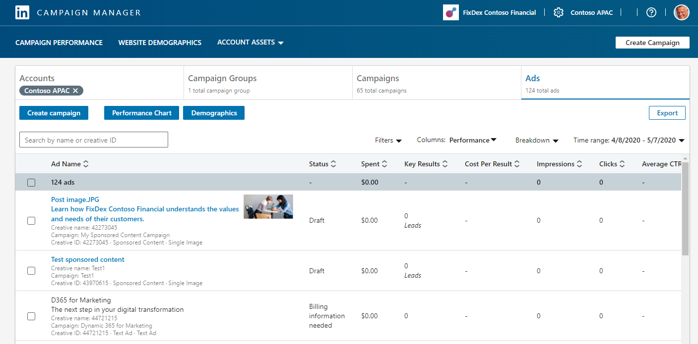
Campaign Manager
Campaign Manager is LinkedIn’s ad management tool
Empowers anyone to
create
launch
evaluate
the performance of LinkedIn ad campaigns
link

Slide 14
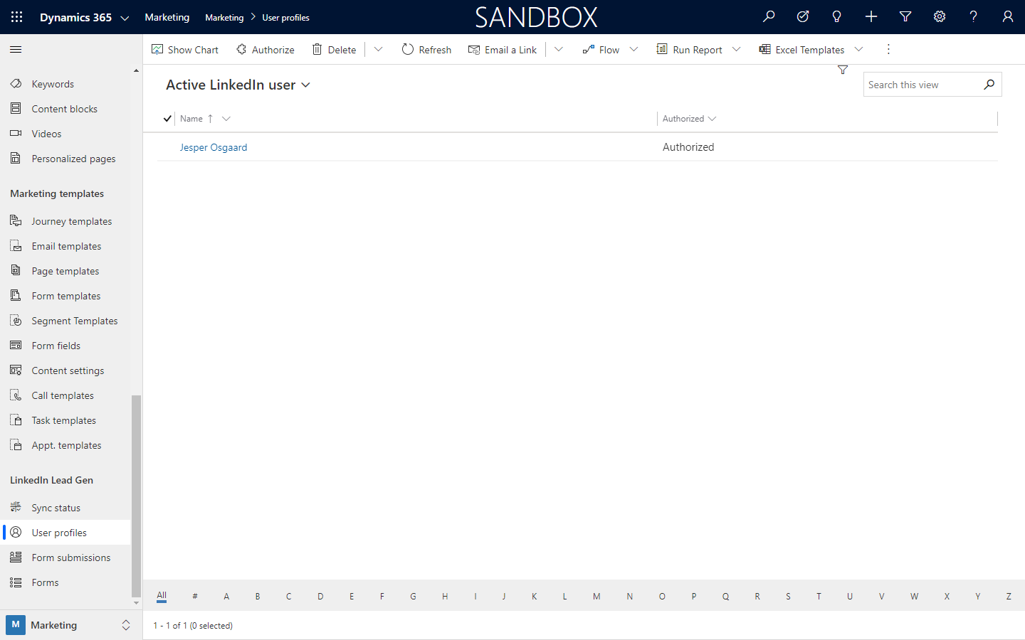
Authorize
To use LinkedIn Lead Gen, you must authorize Dynamics 365 Marketing to connect to LinkedIn using an existing LinkedIn account that has access to LinkedIn Campaign Manager
2
1

Slide 15
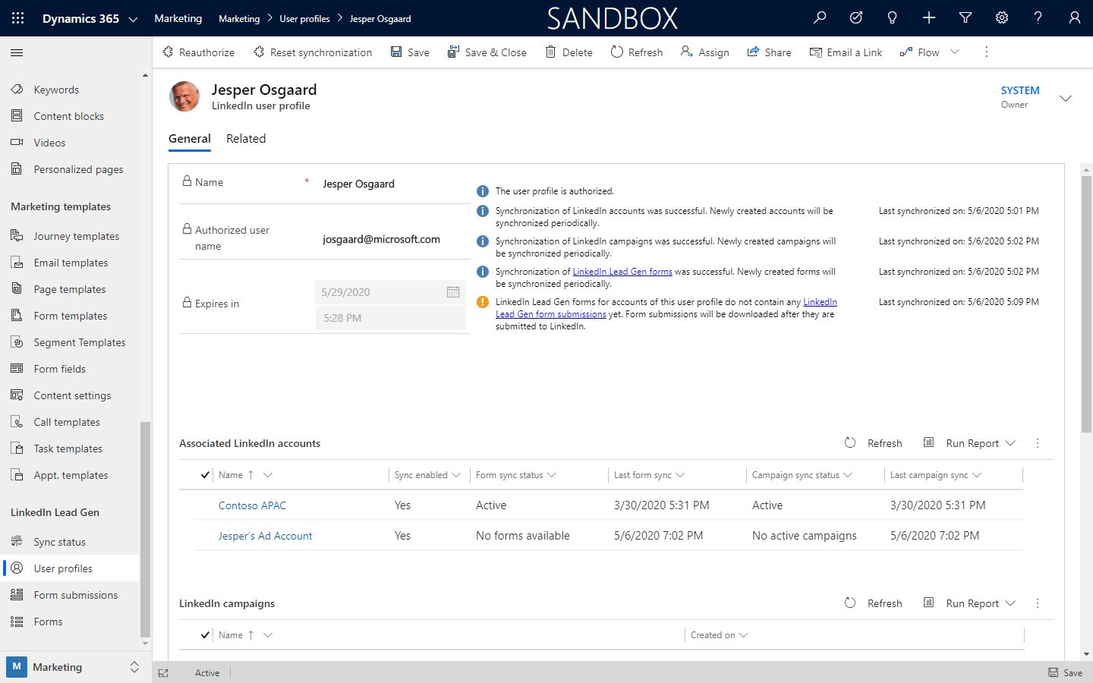
User Profile Page
After synchronizing the user profile the user profile page shows
synch status
associated accounts
campaigns
lead gen forms
1

Slide 16
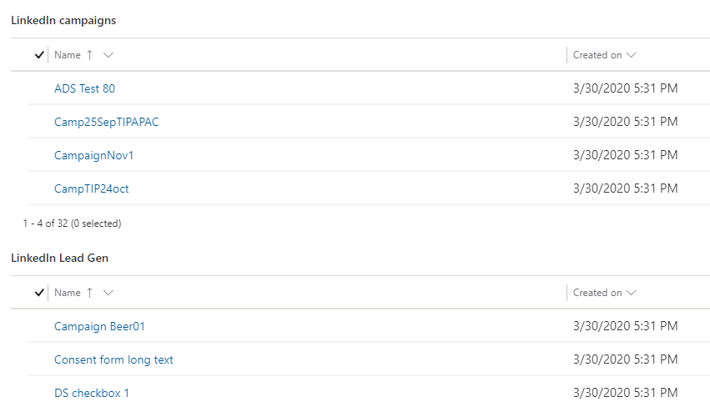
User Profile Page
After synchronizing the user profile the user profile page shows
synch status
associated accounts
campaigns
lead gen forms
2
3
4

Slide 17
Lead Gen Form
How it works in Campaign Manager

Slide 18
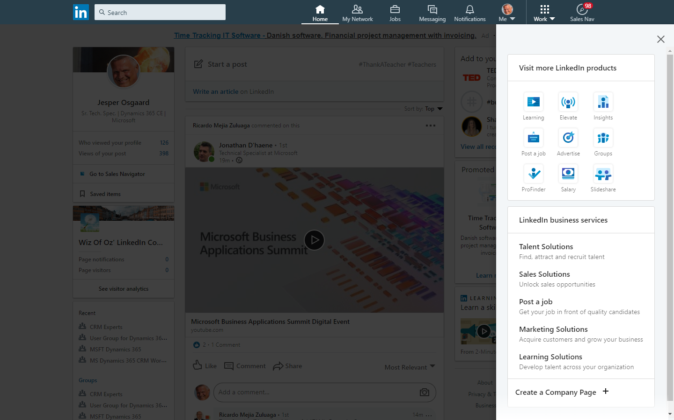
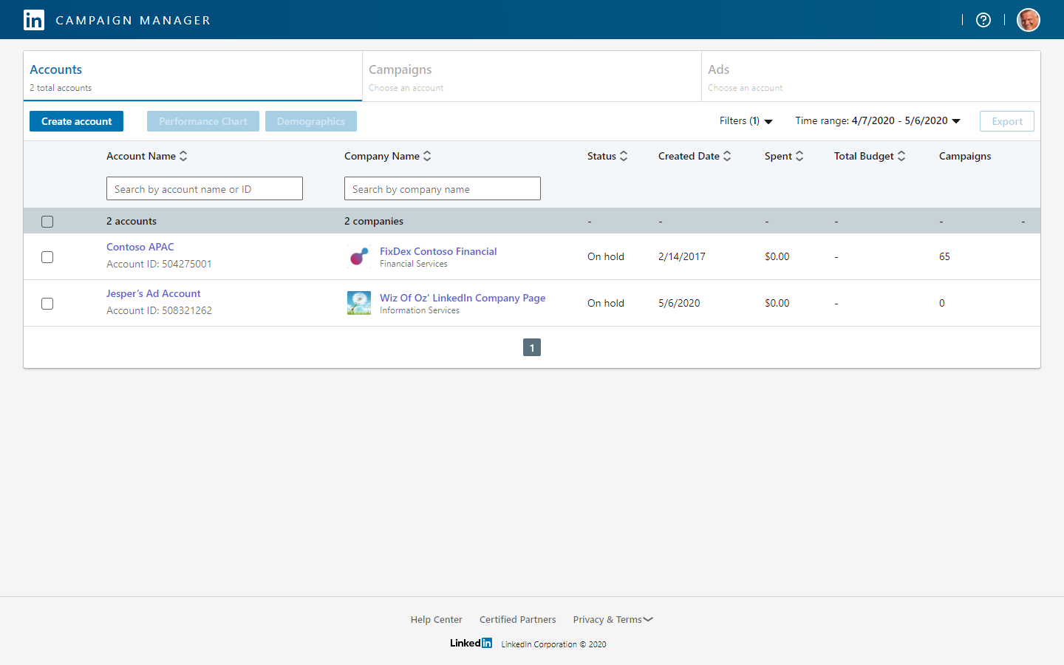
Navigate to the Campaign Manager
LinkedIn > Work (1) > Advertise (2) > Campaign Manager
1
2
Notes:
Navigate to the Campaign Manager

Slide 19
Accounts
If needed create an account, then click account
1
2
3

Slide 20
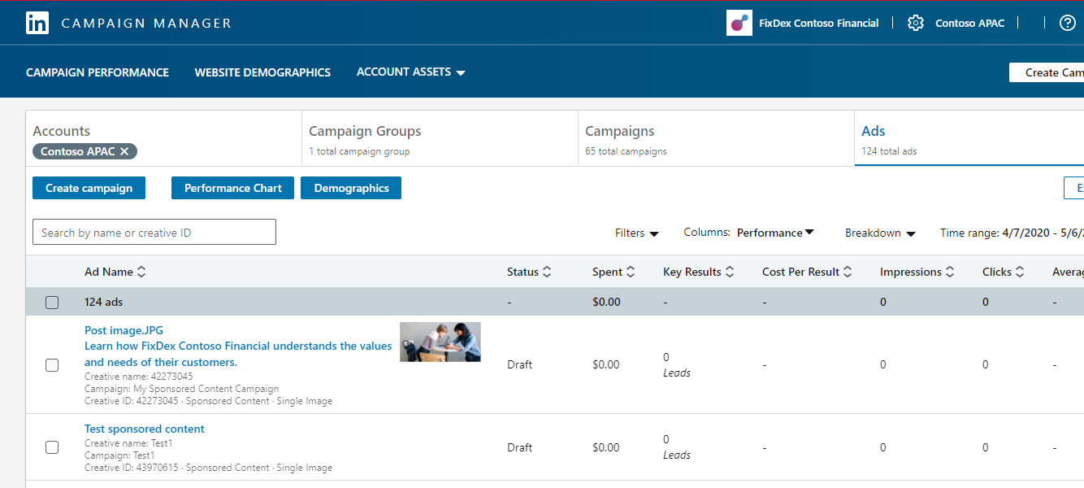
Ads
Open one of the ads in an account
1
2

Slide 21
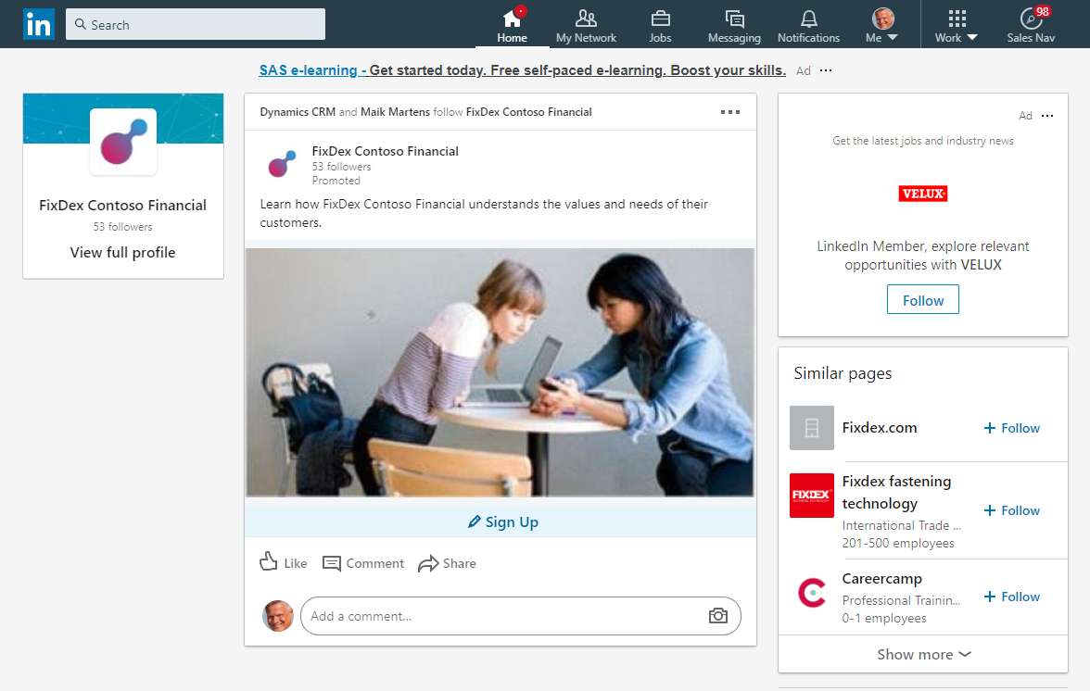
Ad
Ad on account page with link to Lead Gen Form
1
2
3

Slide 22
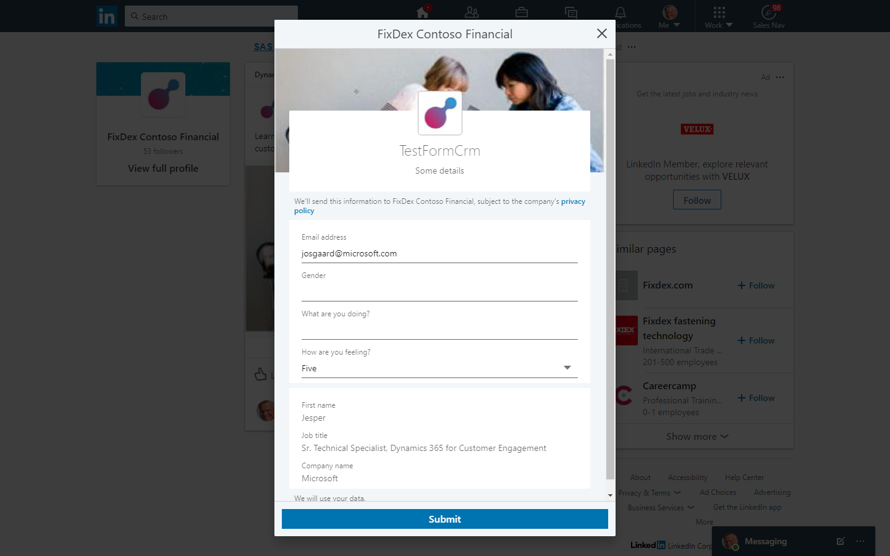
Lead Gen Form
Submissions will be synched to D365M as leads

Slide 23
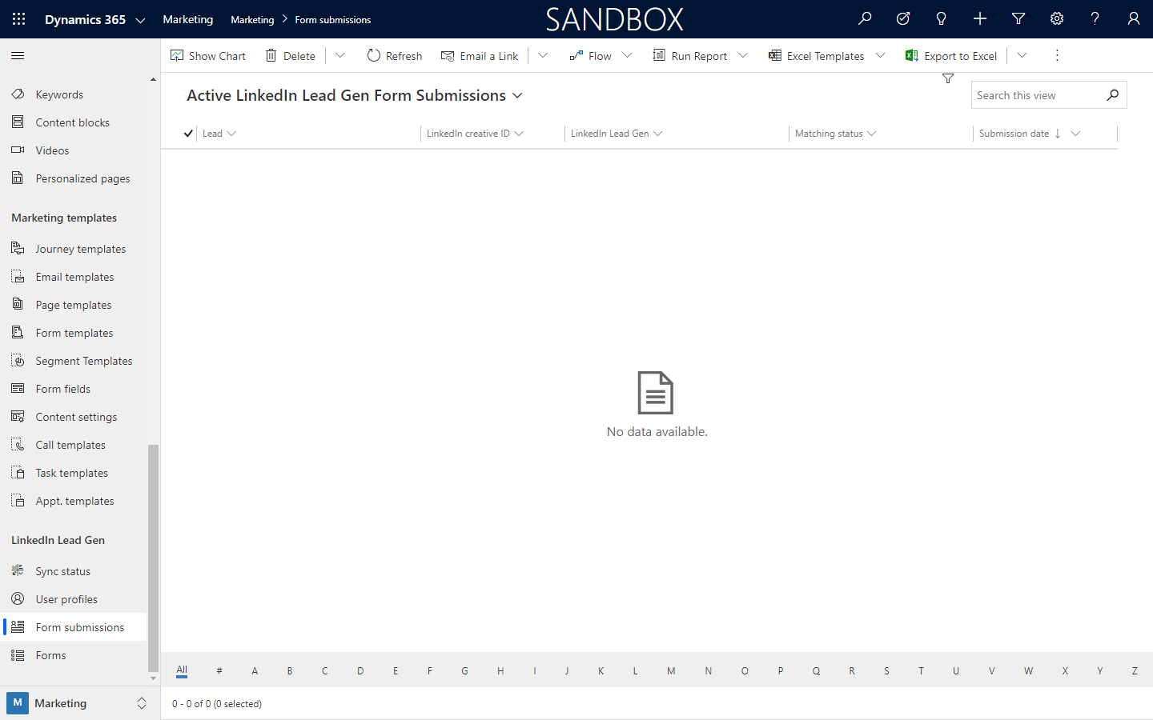
LinkedIn Form Submissions
New LinkedIn leads appear as LinkedIn Form Submissions in Dynamics 365

Slide 24
Agenda
Overview
Lead Gen Integration
Matched Audiences
Customer Journey
Social Posts
Recap

Slide 25
Agenda
Overview
Lead Gen Integration
Matched Audiences
Customer Journey
Social Posts
Recap

Slide 26
Create LinkedIn Matched Audiences
Based on Dynamics 365 Marketing segments

Slide 27
Create LinkedIn Matched Audiences
LinkedIn Matched Audiences is a LinkedIn feature that lets you match a collection of contacts stored on an external system to an audience of LinkedIn members with matching email addresses

Slide 28
Create LinkedIn Matched Audiences
Dynamics 365 Marketing comes ready to take advantage of this capability, so you can leverage your Dynamics 365 Marketing static segments to create a matching audience of LinkedIn members.

Slide 29
Create LinkedIn Matched Audiences
Then, when you run a campaign on LinkedIn, you can
target the same segments that you set up in Dynamics 365 Marketing
turn any leads generated on LinkedIn into Dynamics 365 leads through the LinkedIn Lead Gen Forms integration feature

Slide 30
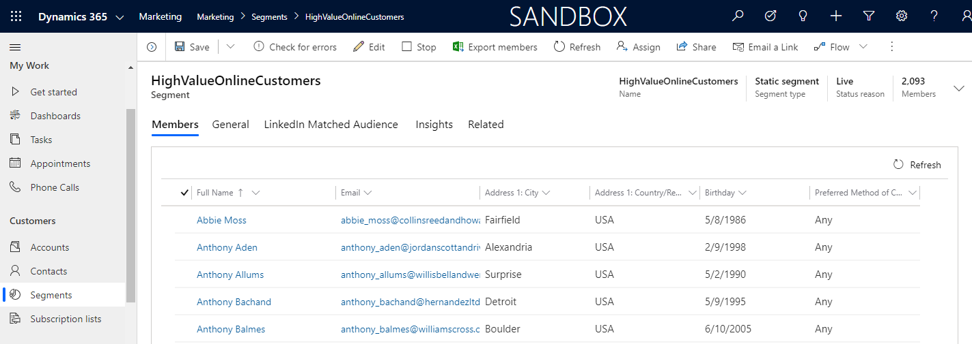
Static Live segment
LinkedIn Matched Audience tab
1
2
3

Slide 31
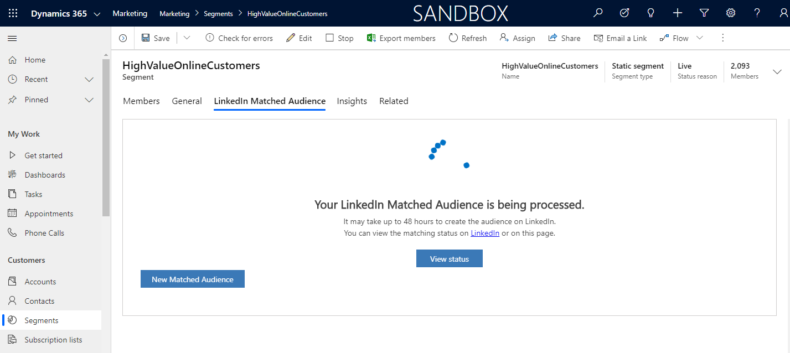
Static Live segment
LinkedIn Matched Audience tab

Slide 32
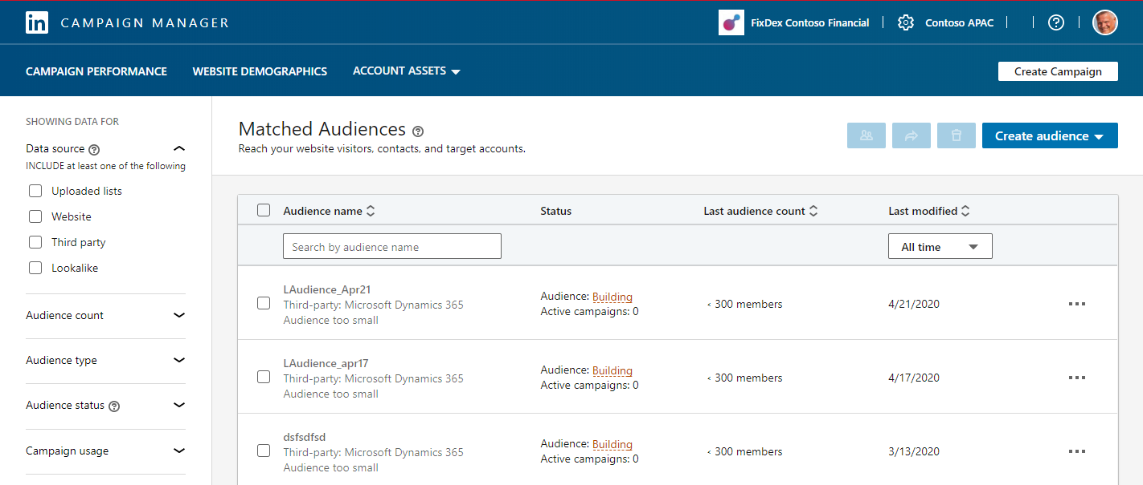
Access matched audiences in Campaign Manager
Account Assets
1
2

Slide 33
Agenda
Overview
Lead Gen Integration
Matched Audiences
Customer Journey
Social Posts
Recap

Slide 34
Agenda
Overview
Lead Gen Integration
Matched Audiences
Customer Journey
Social Posts
Recap

Slide 35
Campaign and Trigger tiles
React to Lead Gen Form submissions in Customer Journeys

Slide 36
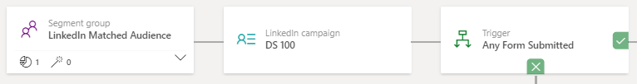
LinkedIn tiles in customer journey
To use the LinkedIn Campaign tile, you must first do the following:
Create an account on LinkedIn that is enabled for marketing
Create a campaign on LinkedIn that includes a LinkedIn Lead Gen Form (link)
Set up the LinkedIn Lead Gen feature in Dynamics 365 Marketing so you can link to your LinkedIn account and sync your LinkedIn campaigns back to Dynamics 365 Marketing (link)

Slide 37
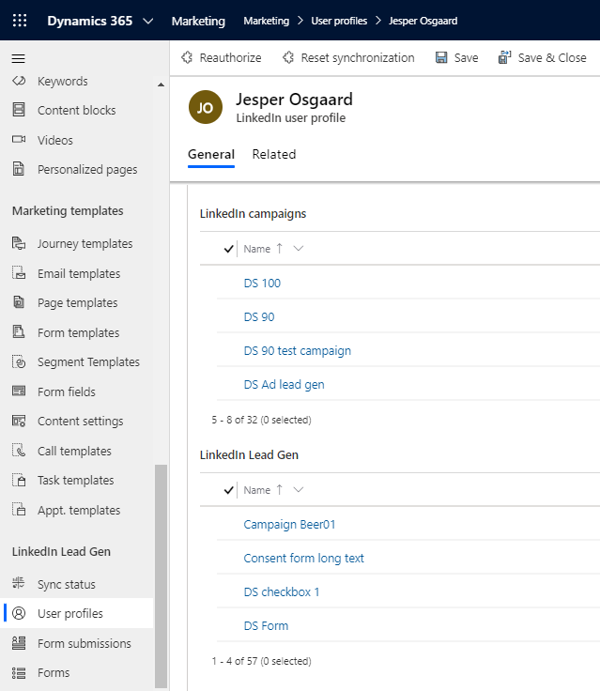
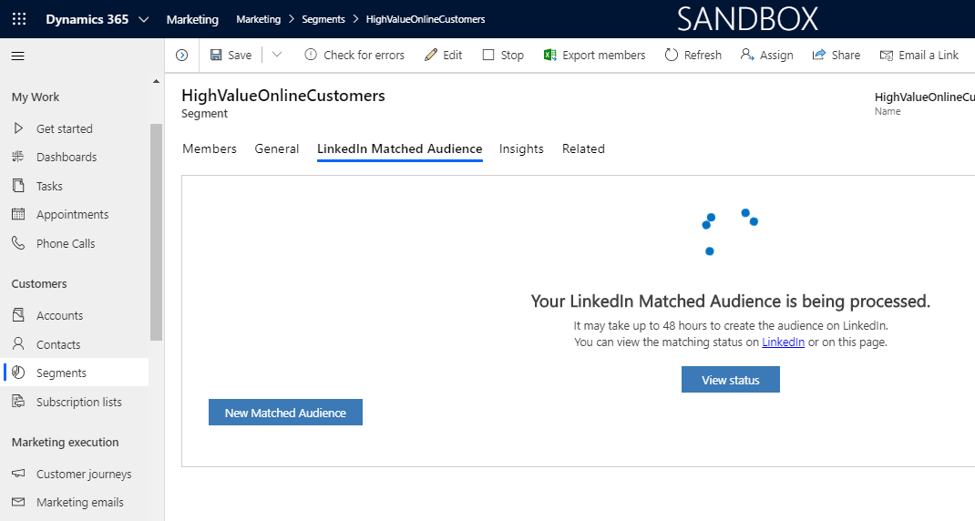
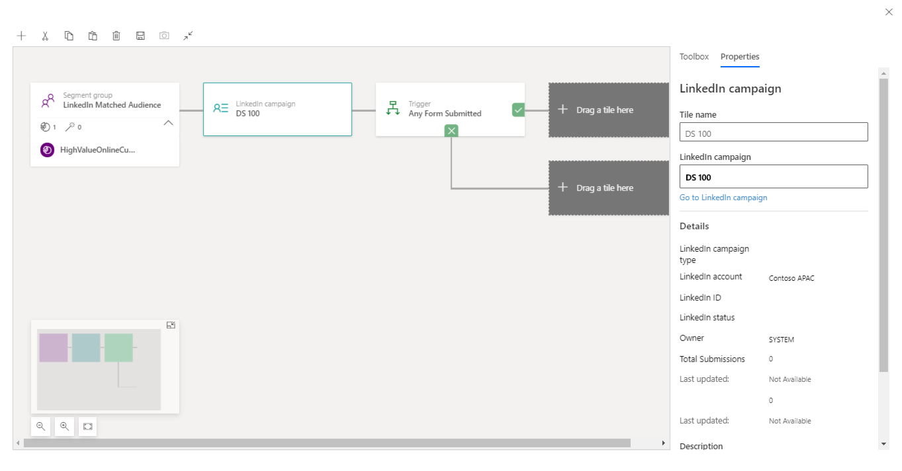
LinkedIn Campaign Tile
Drag into canvas from Customer Journey Toolbox and configure

Slide 38
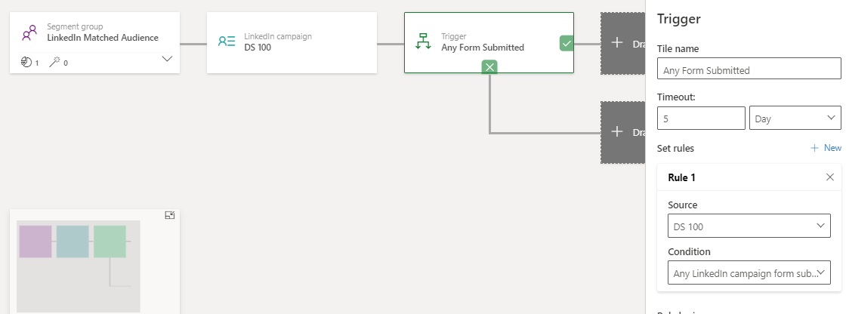
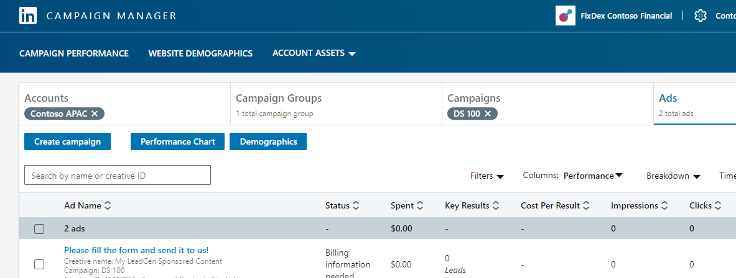
Trigger
Branch on form submissions
1
1
2
2

Slide 39
Agenda
Overview
Lead Gen Integration
Matched Audiences
Customer Journey
Social Posts
Recap

Slide 40
Agenda
Overview
Lead Gen Integration
Matched Audiences
Customer Journey
Social Posts
Recap

Slide 41
Schedule and publish social posts
to LinkedIn from Dynamics 365 Marketing

Slide 42
Post updates directly from Dynamics 365 to LinkedIn
Dynamics 365 Marketing can schedule and post messages directly through any of your organization's social-media accounts, including on Facebook, Twitter, and LinkedIn.
This lets you establish your content and posting schedule using the Dynamics 365 marketing calendar, where you’ll also be able to see a full history of your posts to all supported social media sites.

Slide 43
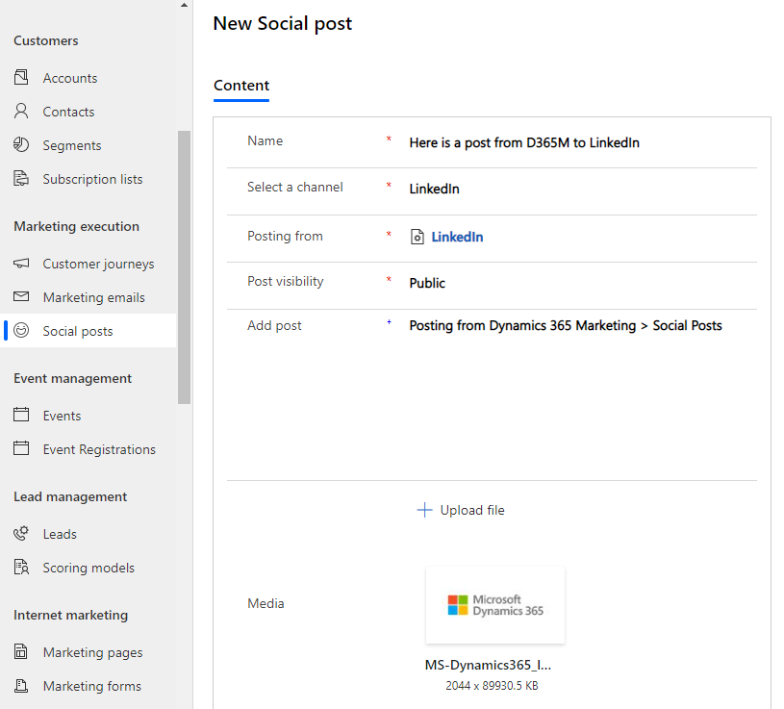
Post updates directly from Dynamics 365 to LinkedIn
Dynamics 365 Marketing can schedule and post messages directly through any of your organization's social-media accounts, including on Facebook, Twitter, and LinkedIn.
This lets you establish your content and posting schedule using the Dynamics 365 marketing calendar, where you'll also be able to see a full history of your posts to all supported social media sites.

Slide 44
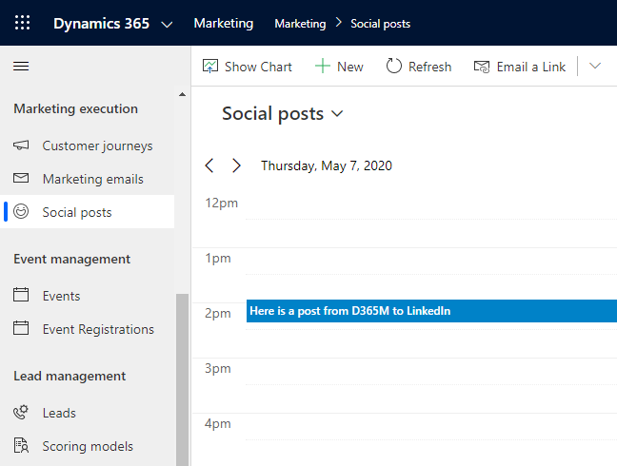
Post updates directly from Dynamics 365 to LinkedIn
Dynamics 365 Marketing can schedule and post messages directly through any of your organization's social-media accounts, including on Facebook, Twitter, and LinkedIn.
This lets you establish your content and posting schedule using the Dynamics 365 marketing calendar, where you'll also be able to see a full history of your posts to all supported social media sites.

Slide 45
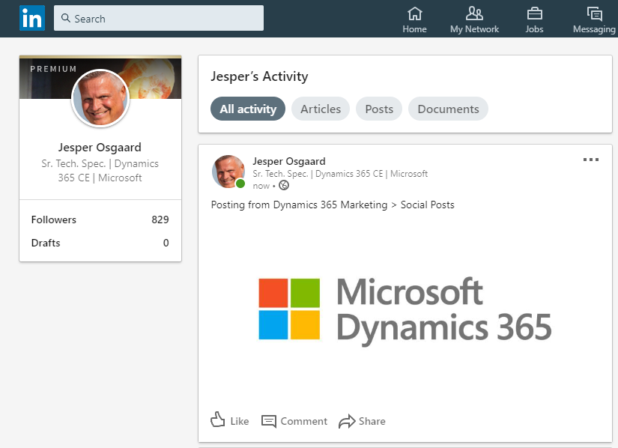
Post updates directly from Dynamics 365 to LinkedIn
Dynamics 365 Marketing can schedule and post messages directly through any of your organization's social-media accounts, including on Facebook, Twitter, and LinkedIn.
This lets you establish your content and posting schedule using the Dynamics 365 marketing calendar, where you'll also be able to see a full history of your posts to all supported social media sites.

Slide 46
Agenda
Overview
Lead Gen Integration
Matched Audiences
Customer Journey
Social Posts
Recap

Slide 47
Agenda
Overview
Lead Gen Integration
Matched Audiences
Customer Journey
Social Posts
Recap

Slide 48
Marketing on LinkedIn with Dynamics 365 Marketing
Integration points include:
Import leads generated by LinkedIn Lead Gen Forms into Dynamics 365 Marketing
Create LinkedIn Matched Audiences based on Dynamics 365 Marketing segments
Design customer journey triggers that react to Lead Gen Form submissions
Schedule and publish social posts to LinkedIn from Dynamics 365 Marketing

Slide 49
Resourses
Microsoft Docs
Integrate LinkedIn marketing with Dynamics 365 Marketing – link
Lead Gen Forms – link
Matched Audiences – link
Campaign Tile and Triggers - link
Social Posts – link
Blog Posts
LinkedIn Matched Audience - link

Slide 50
Dynamics 365 Marketing - One Stop document
FY20 –http://aka.ms/ocp/d365marketing

Slide 51

THANK
YOU!
josgaard@microsoft.com
sobordia@microsoft.com

